Slide 1
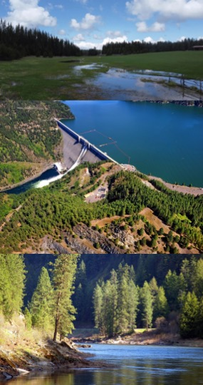



The Corps Library for Environmental Analysis and Restoration of Watersheds (ClearWater): An Integrated Multi-Dimensional Water Quality Modeling System
Technology Spotlight
Todd Steissberg, PhD, PE
Research Environmental Engineer
Team Lead: Ecohydrology and Environmental Modeling
Environmental Laboratory
U.S. Army Engineer Research and Development Center (ERDC)
August 13, 2024
US Army Corps
of Engineers
DISCOVER | DEVELOP | DELIVER

Slide 2
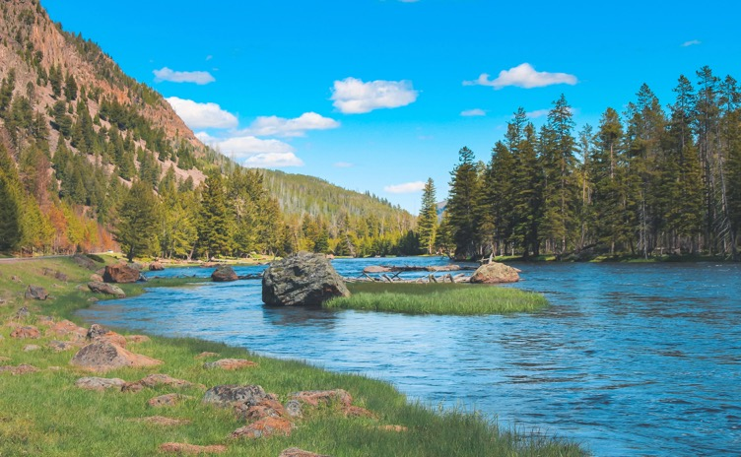
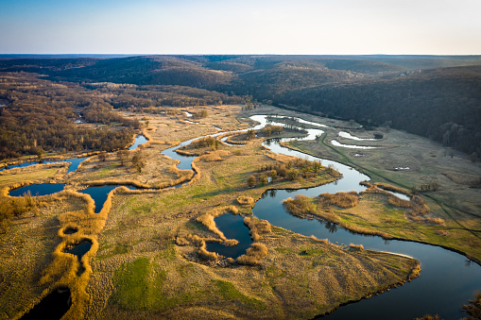
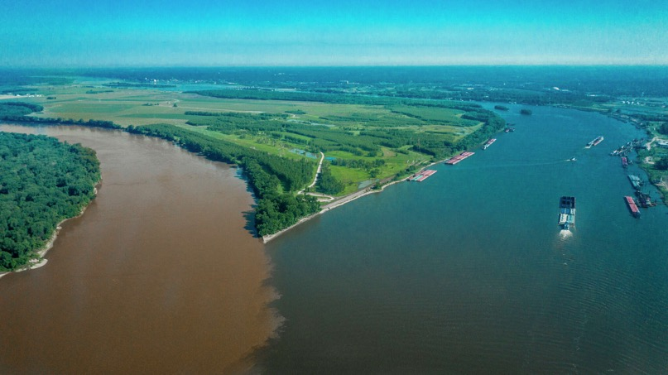
Project Team
Investigators/Roles
Todd Steissberg (ERDC-EL-EPW)
Project PI, coordination, design, prototyping
Isaac Mudge (USACE-MVN)
Developed new Temperature Simulation Module (TSM)
Kelsey Walak (USACE-SPK)
Developed new Nutrient Simulation Module (NSM)
Lauren Melendez (ERDC-EL-EPW)
Coordination
Testing
Partners:
Hydrologic Engineering Center (HEC)
Mark Jensen
Alex Sanchez
Coastal & Hydraulics Laboratory (CHL)
Chuck Downer
Aaron Byrd
LimnoTech
Anthony Aufdenkampe
Sarah Jordan
Jason Rutyna
Xavier Nogueira
Billy Johnson
Portland State University
Zhonglong Zhang
Notes:
Photo 1: Yellowstone National Park, showing complexity of landscape, flow, and vegetation
Photo 2: Complex and meandering flow across a landscape

Slide 3
Sponsor Details
Proponents: R&D Direct, Brian Zettle (TNTCX), Jeff Tripe (NWK)
Stakeholders: USACE Districts, agency partners (USGS, USBR, EPA, state/local agencies), restoration and recovery programs, e.g., Missouri River Recovery Program (MRRP) and Columbia River Watershed
Supporting Programs: EMRRP (CW) and Next Generation Ecological Modeling Tools (Congressional Interest CW)
Scope: Develop an integrated ecohydrology modeling system that simulates heat and nutrient flow through ecosystems.
Cost: $975K (EMRRP), $1.2M (Next Gen Ecological Modeling)
Timeline: 2018-2024
Notes:
Photo 1: Yellowstone National Park, showing complexity of landscape, flow, and vegetation
Photo 2: Complex and meandering flow across a landscape

Slide 4
Challenge and Context
Nutrient flow through ecosystems has a profound impact on how species utilize resources across watershed scales.
Primary production
Species distribution and abundance
Ecosystem productivity and stability
Community composition and diversity
Carbon sequestration
Human-caused disturbances are disrupting nutrient cycling, destabilizing ecosystem health and functioning.
Notes:
Photo 1: Yellowstone National Park, showing complexity of landscape, flow, and vegetation
Photo 2: Complex and meandering flow across a landscape

Slide 5
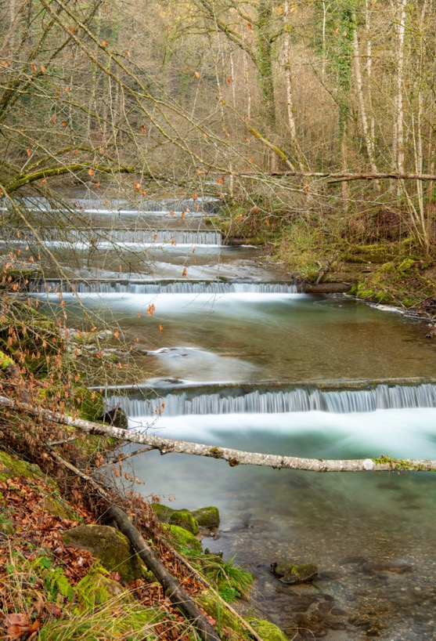
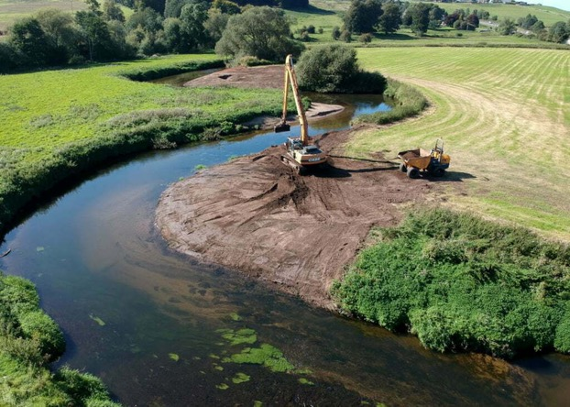
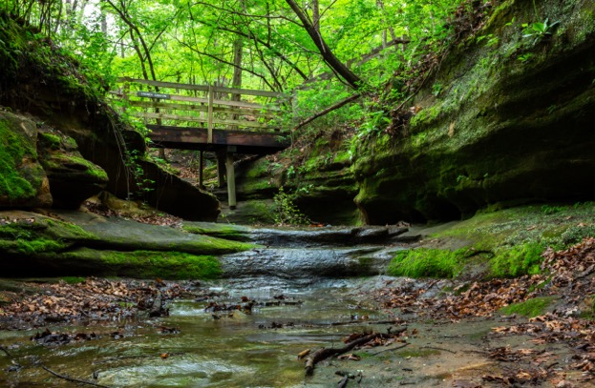
Challenge and Context
Nutrient flow through ecosystems was not being simulated across watershed scales using a flexible integrated modeling system.
This hindered the ability of USACE Districts, partners, and stakeholders to:
Assess ecosystem risk analysis
Predict morbidity and mortality of key species
Predict spatial distribution of species across landscapes in response to changing conditions
Identify effective ecosystem restoration strategies and management interventions
Design measures to control the spread of invasive species
Notes:
Photo 1: Terraced stream restoration project
Photo 2: River restoration, Trent River Valley, England

Slide 6



Action
Develop an integrated ecohydrology modeling system that simulates heat and nutrient flow through ecosystems.
Water Resources Models
Water Quality Models (Nutrients & Temperature)
Ecological Models

Slide 7
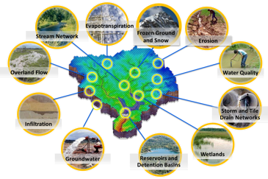
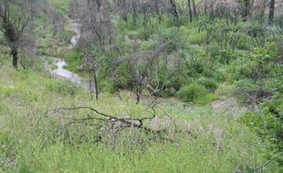
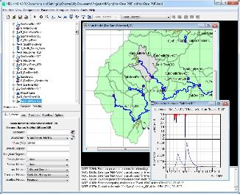
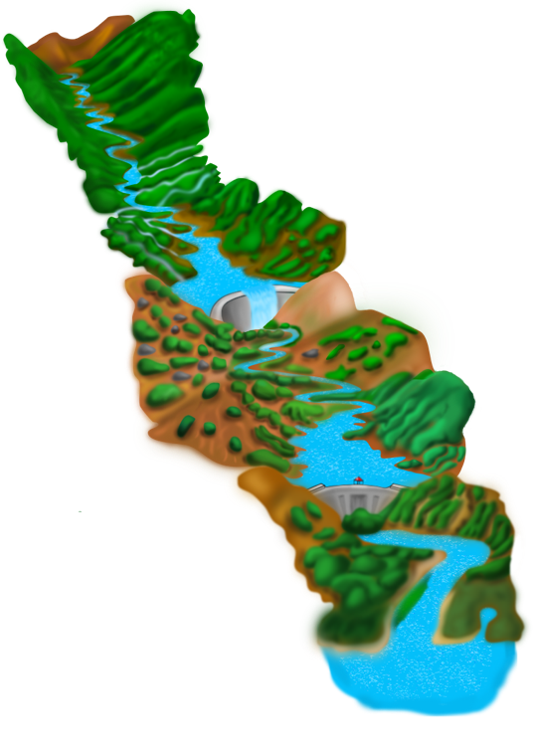
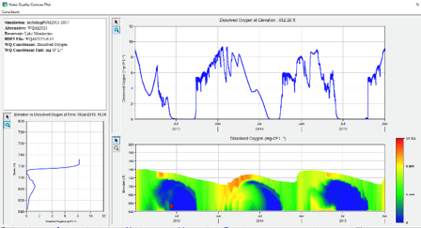
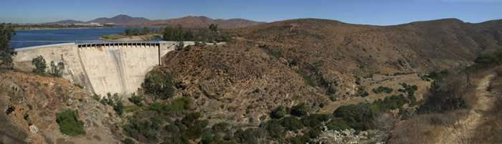
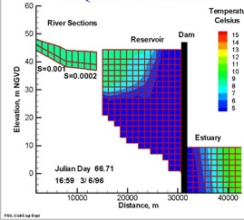
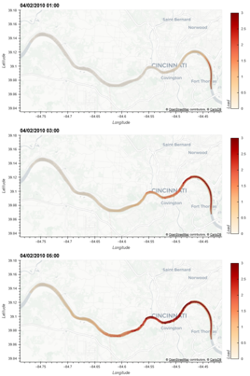
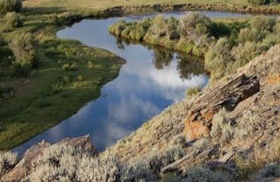
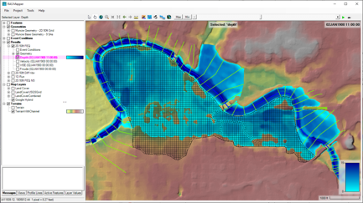
Water Quality and Environmental Systems Modeling
Temperature
Nutrients
Dissolved Oxygen
Algae
Metals
Contaminants
ERDC’s Corps Library for Environmental Analysis and Restoration of Watersheds (ClearWater) provides environmental simulation capabilities that leverage existing hydrologic and hydraulic (H&H) models.
Water quality modeling tools:
Watershed Runoff:
GSSHA: Surface and sub-surface water quality modeling
HEC-HMS: Surface runoff temperature modeling
Reservoirs:
CE-QUAL-W2: 2D reservoir-river hydrodynamics and water quality modeling
HEC-ResSim: Reservoir operations and water quality modeling
Rivers and Floodplains:
HEC-RAS: 1D River hydraulics and water quality & vegetation modeling
ClearWater-Riverine: 2D River-floodplain hydraulics and water quality modeling with HEC-RAS-2D
Estuary
Key: ERDC-EL – ERDC-CHL – HEC

Slide 8
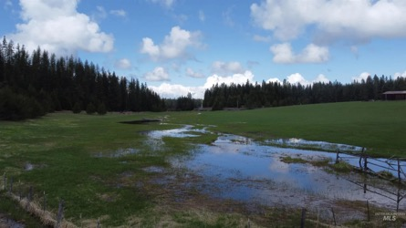
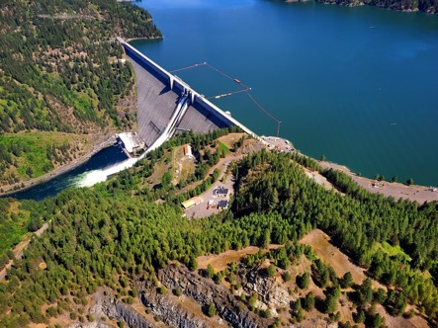
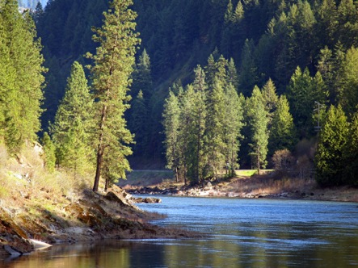
ClearWater: Next Generation Integrated Water Quality Modeling
ClearWater: Corps Library for Environmental Analysis and Restoration of Watersheds
Purpose: Link environmental models with existing water resources models that simulate runoff, rivers, and reservoir hydraulics and hydrology
ClearWater provides environmental simulation capabilities that are designed to leverage existing water resources models.
The ClearWater water quality modules simulate constituent kinetics, heat budget processes, and vegetation growth cycles. Capabilities include:
NSM: Nitrogen, phosphorus, and carbon cycling; dissolved oxygen, algae, etc.
TSM: Temperature (heat budget)
GSM: General Constituents
CSM: Organic and inorganic contaminants
MSM: Mercury
ClearWater contains legacy modules written in Fortran and C++ and next-generation modules written in Python (NSM and TSM)
Engine computes the transport (advection and diffusion) of heat and constituent mass across the watershed
Data visualization capabilities
Framework to integrate multiple models.
Runoff
Reservoirs
Rivers

Slide 9
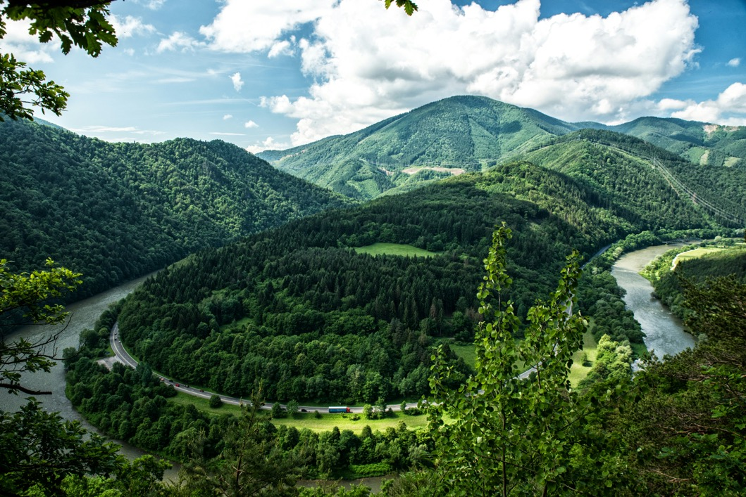

ClearWater-Riverine
Clearwater-Riverine simulates temperature and advanced nutrient cycling in branching river systems and floodplains, incorporating hydrodynamic, water quality, and meteorologic inputs from multiple data sources and models.
Flows: The model grid, volumetric flow, velocities, depths, diffusivity, etc. are provided by existing 2D water resources models.
HEC-RAS (2D)
GSSHA (in progress)
Modules: Water quality kinetics and heat budget simulation capabilities in ClearWater-Riverine are furnished by ERDC's ClearWater modules (e.g., NSM).
Transport: The ClearWater transport engine computes advection-diffusion of heat and mass through the model network.
Framework: The ClearWater framework links all the components together and performs the water quality compute sequence.
Currently design is based on decoupled modeling, i.e., the flows are pre-computed by the hydro models.

Slide 10




Modern Scientific Python
Built using the cloud-native geospatial Python stack being widely adopted by NOAA, USGS, NASA, etc.
An object-oriented architecture inspired by xarray-simlab / fastscape and CSDMS LandLab
Automated unit testing
https://numfocus.org/sponsored-projects
Notes:
Our framework is designed to scale computations from a single set of values to multi-dimensional arrays, as shown in the icon for the xarray package, and scale from laptop to parallel computing to distributed cloud computing, powered by the Dask library that is built-in under-the-hood for xarray. All these libraries are very well supported by foundations, industry, and federal agencies.
We are following modern numerical modeling coding patterns in widespread use by the geosciences community.

Slide 11


Model Coupling
Modeling community moving toward systems of coupled models from modular model components.
BMI 2.0 has become the standard for model coupling
Basic Model Interface (BMI)
Provides a common set of functions
To run models and exchange information and data on grids, variables, timesteps, etc.
Shares data among models using a zero-copy approach
Each model reads and writes to the same in-memory object using pointers
Supports models written in C, C++, Fortran, Java, Python, JavaScript, Julia
NOTE: BMI must be implemented in the source code of a model before it can be used to couple that model to other BMI-compliant models
Learn more: https://bmi.readthedocs.io

Slide 12
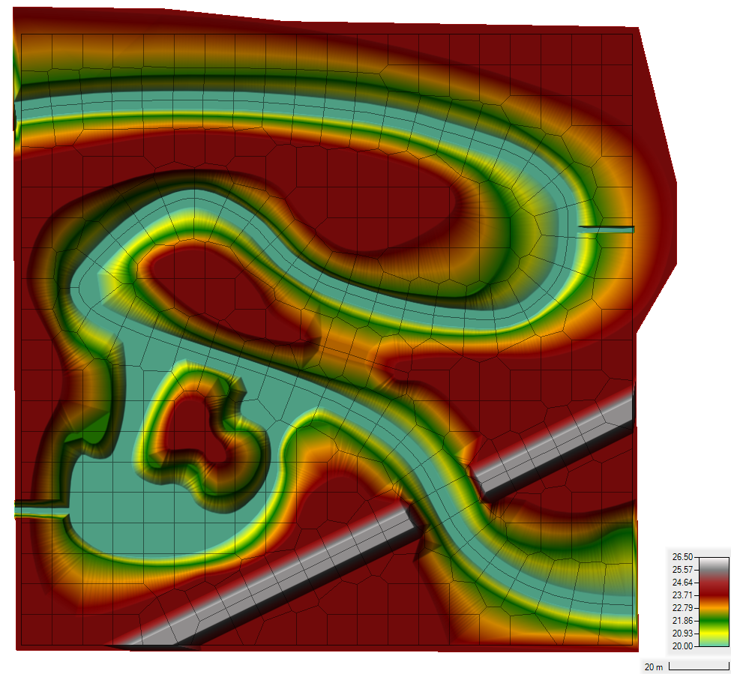
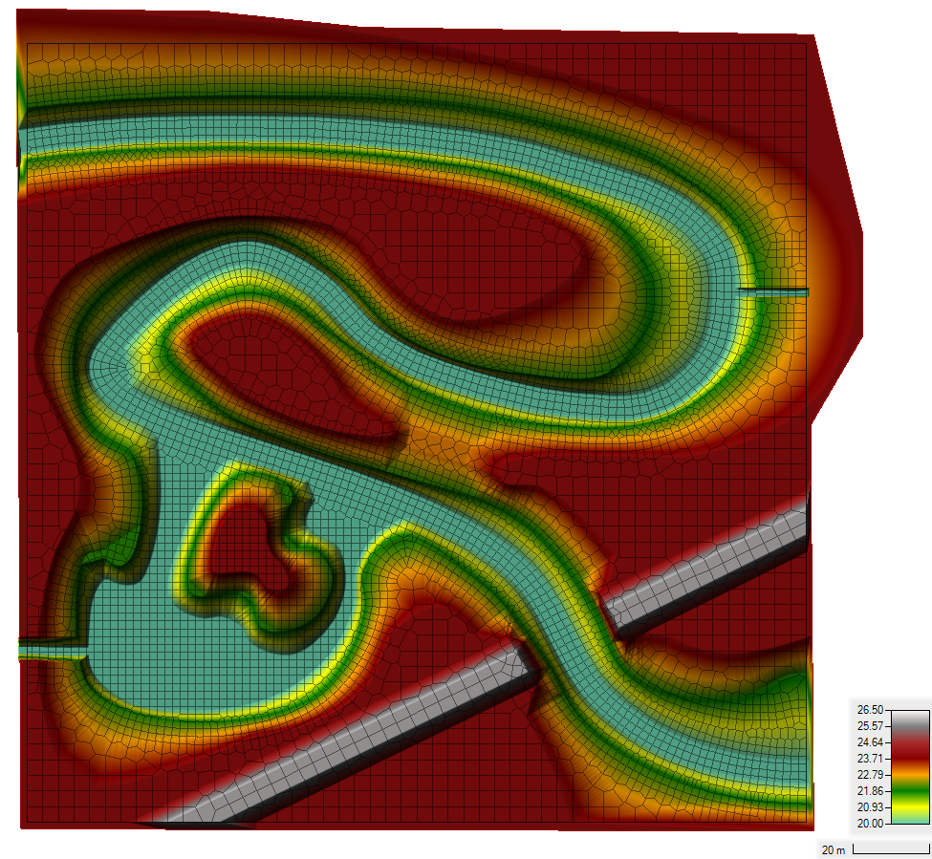
Demo Case Study: Sumwere Creek — Domain & Mesh
Coarse Mesh Fine Mesh
Notes:
Flow field is from HEC RAS-2D output in this case
Domain: 200 meters by 200 meters
Fictitious Topography/Bathymetry
- Bathymetry bottom elevation constant at 20 m
- Floodplain elevation constant at 24 m
- Roadway elevation constant at 26 m
Two Unstructured Meshes Tested
- Coarse Mesh: Base Mesh of 10 m by 10 m
- Fine Mesh: Base Mesh of 4 m by 4 m with a 2 m by 2 m refinement within the creek

Slide 13
Demo Case Study: Sumwere Creek — Hydrodynamic Boundary Conditions
Coarse Mesh Fine Mesh
Upstream: 3 cms
Spring:
1 cms
Powerplant:
0.5 cms
Downstream:
20.75 m
Notes:
HEC-RAS Boundary Conditions
- Upstream Flow for Sumwere Creek constant at 3 cms (1st hour ramping from zero)
- Downstream Stage for Sumwere Creek constant at 20.75 m
- Flow for Cold Spring Creek constant at 1 cms (1st hour ramping from zero)
- Flow for Power Plant Chute constant at 0.5 cms (1st hour ramping from zero)

Slide 14
Demo Case Study: Sumwere Creek — Temperature Boundary Conditions
Coarse Mesh Fine Mesh
Upstream: 15˚C
Spring:
5˚C
Powerplant:
20-25 ˚C
Notes:
Boundary conditions are the same for both the coarse and the fine mesh.
Designed to show longitudinal mixing across the river
Exploration of different extremes (cool water from spring-fed tributary versus warm water from powerplant)

Slide 15
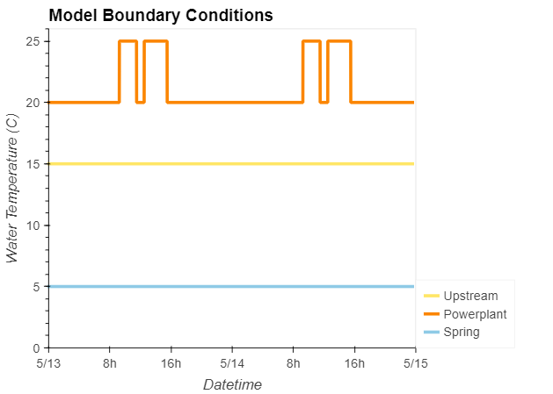
Demo Case Study: Sumwere Creek — Temperature Boundary Timeseries
Coarse Mesh
Upstream: 15˚C
Spring:
5˚C
Powerplant:
20-25 ˚C
Notes:
Timeseries of boundary conditions (stable, except for powerplant discharge)
Powerplant discharge has two peaks during the day (one in the morning, one in the afternoon)

Slide 16
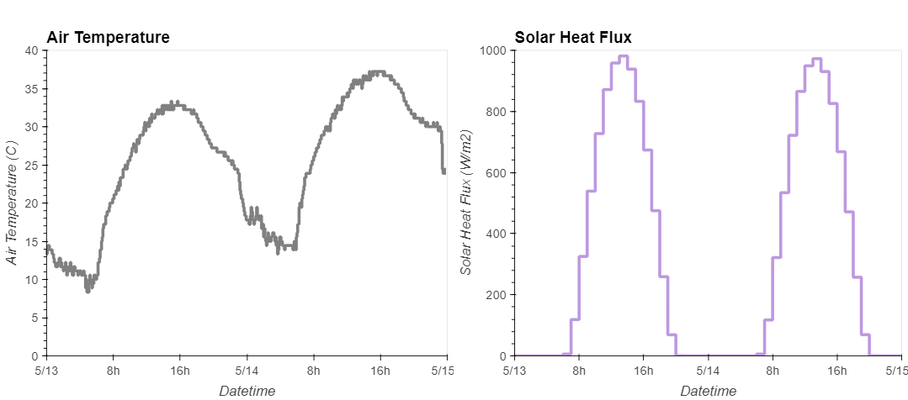
Demo Case Study: Sumwere Creek — Meteorological Timeseries
Notes:
Meteorological timeseries used as inputs to TSM.
Air temperature and solar heat flux both peak during the day and drop at night.
Timeseries from Arizona (extreme cycles to help capture impact of TSM).

Slide 17
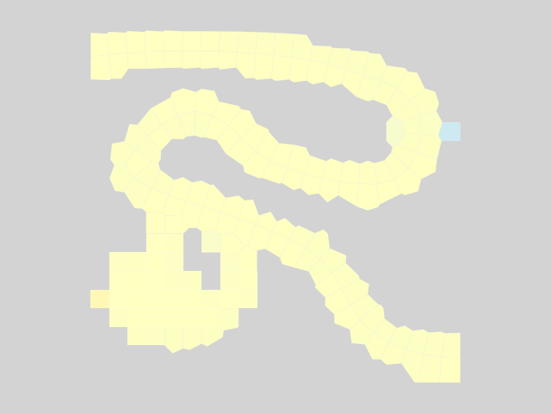
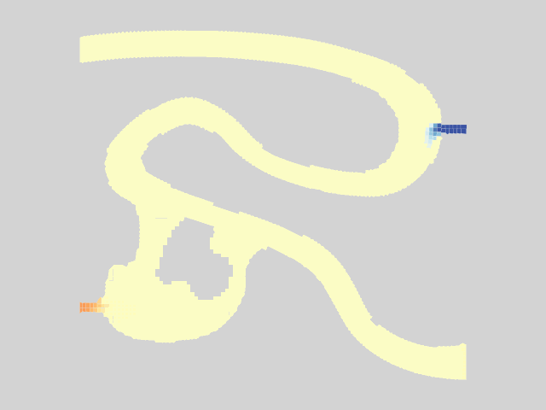
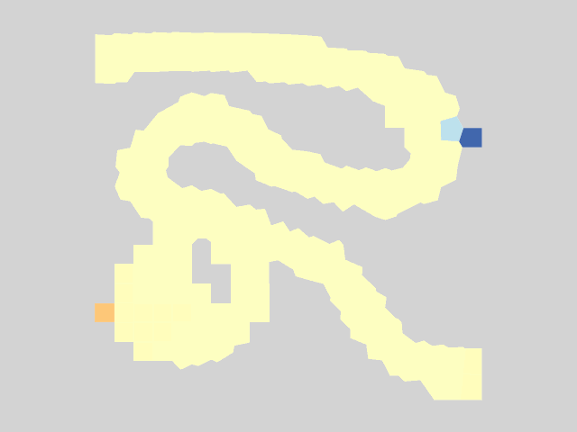
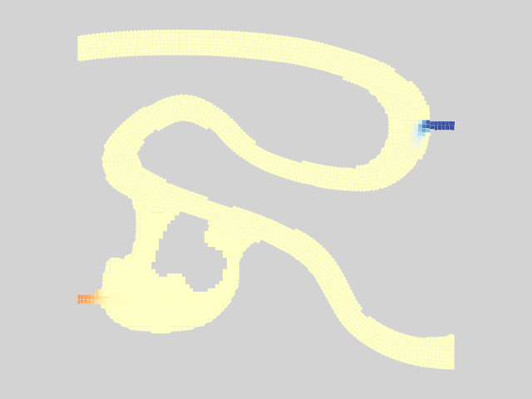
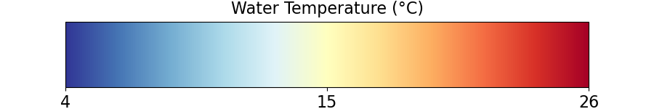
Results – Animation
Coarse Mesh Fine Mesh
Notes:
You can see the mixing.
Ultimately reaches steady state.

Slide 18
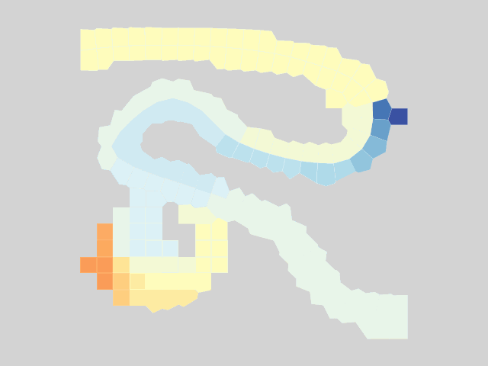
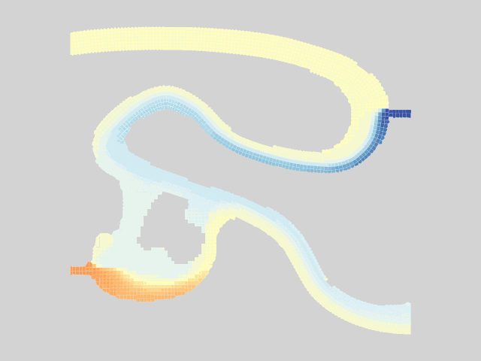

Results – Warm Powerplant Inflows
Coarse Mesh Fine Mesh
Notes:
Pulses from powerplant.
Can see a lot more transverse mixing from the powerplant and spring in the fine mesh compared to the coarse mesh.
Can see more detail on the plume of warm water.
This all shows transport very clearly, but what about our energy budget model / TSM?

Slide 19
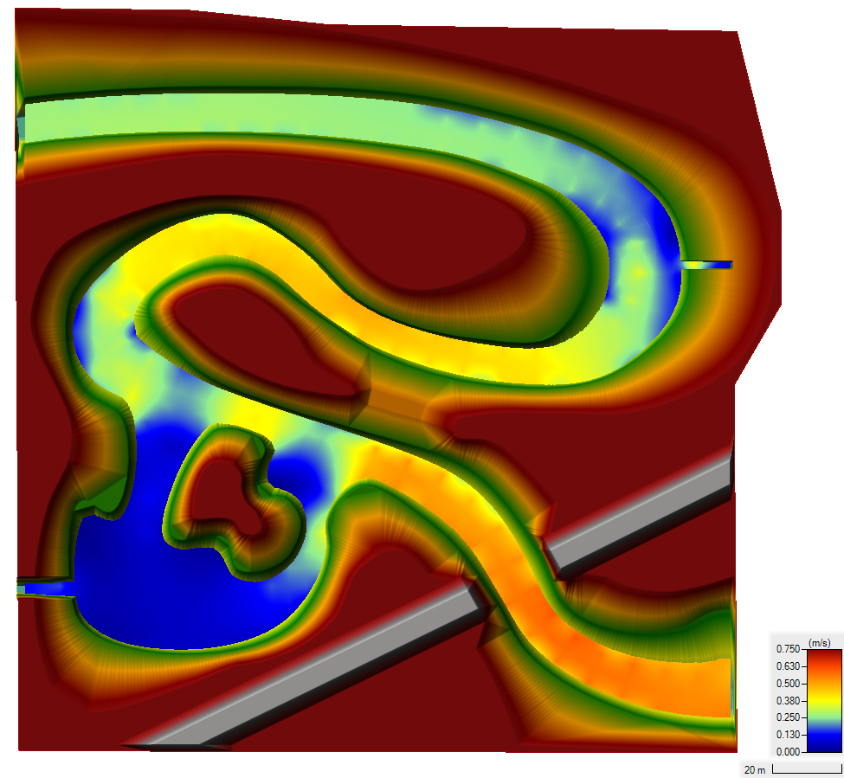
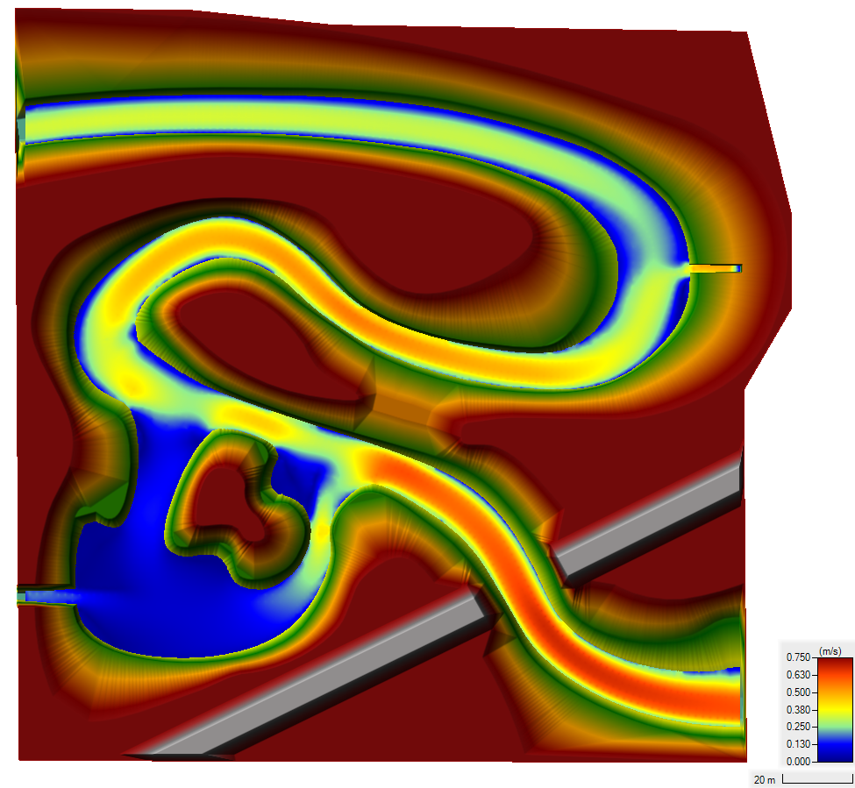
Demo Case Study: Sumwere Creek — Velocity at End of Simulation
Coarse Mesh Fine Mesh
Notes:
Differences in velocities between the meshes are due to varying spatial resolution in each mesh

Slide 20
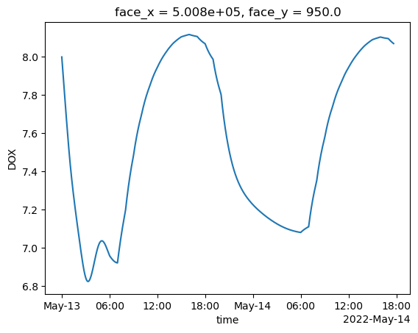
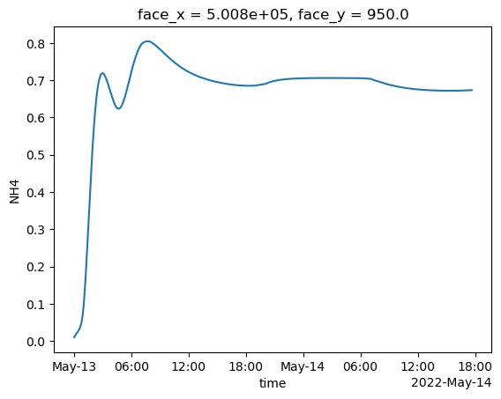
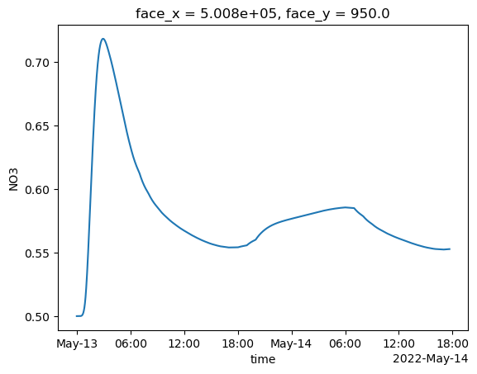
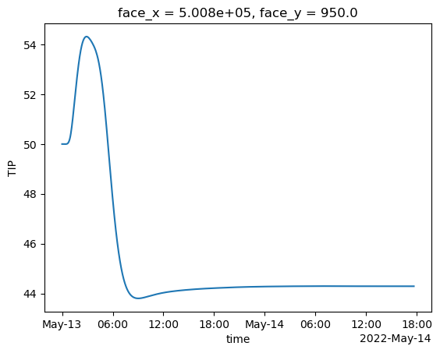
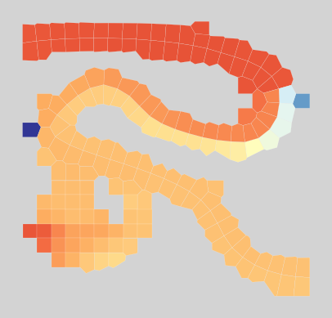
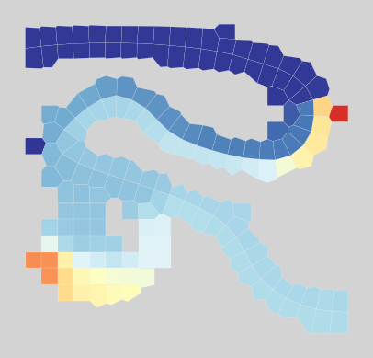
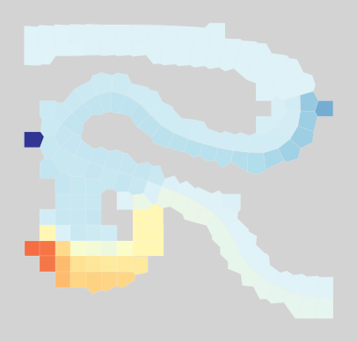
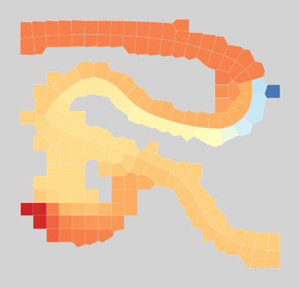
Nutrient Modeling Capabilities
Dissolved Oxygen
Ammonia (NH₄)
Nitrate (NO₃)
Total Inorganic Phosphorus (TIP)
Notes:
Pulses from powerplant.
Can see a lot more transverse mixing from the powerplant and spring in the fine mesh compared to the coarse mesh.
Can see more detail on the plume of warm water.
This all shows transport very clearly, but what about our energy budget model / TSM?

Slide 21
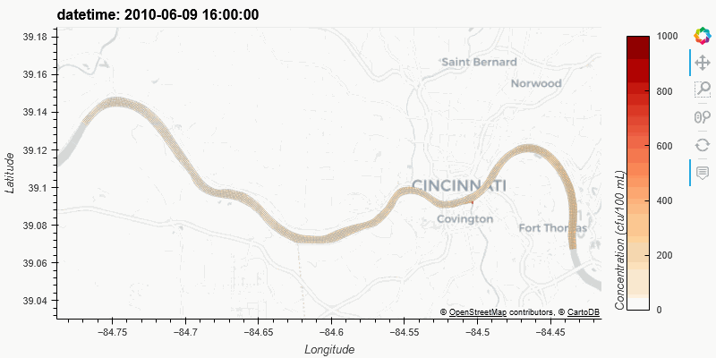
ClearWater-Riverine Example: E. Coli Transport in the Ohio River

Slide 22
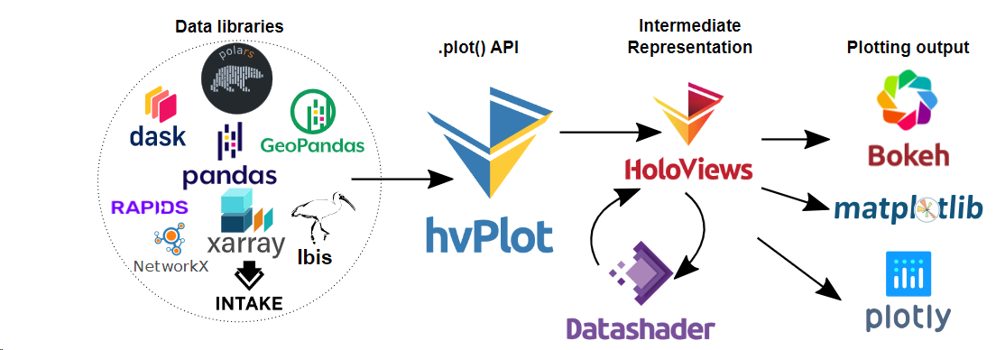


Results
ClearWater’s Python-based framework allows easy integration with powerful interactive visualization packages
Enhanced understanding of complex environmental/ecological outcomes
Iterative analysis and scenario discovery
Multidimensional exploration across time and space
Effective communication of results across teams and stakeholders
Notes:
Building on the shoulders of giants.
We do not build or maintain any of these libraries.

Slide 23
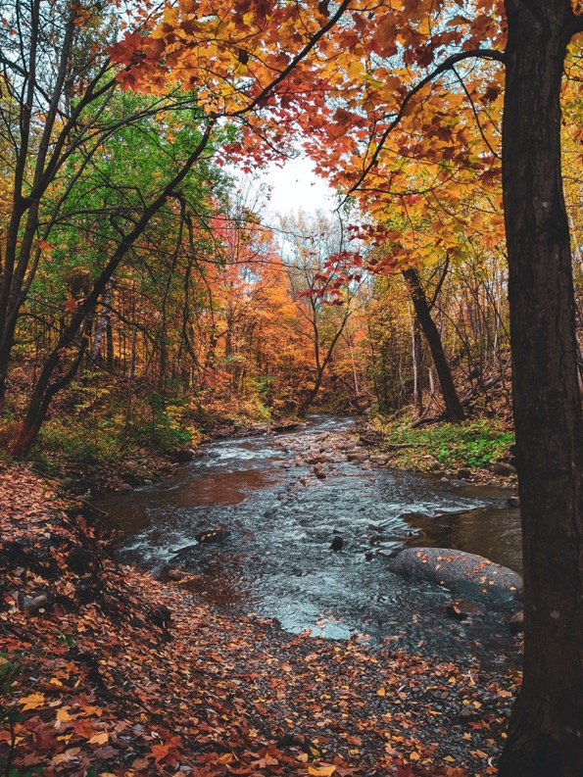
Benefits
Enables a seamless exchange of data and information between different components of an integrated modeling system.
Facilitates data-driven decision-making
Enhances collaboration between scientific disciplines
Integrated models that simulate the interactions between heat, nutrients, water flow, and vegetation enable a comprehensive representation of ecosystem dynamics.
Accurate representation of real-world processes
Enables assessment of the ecological responses to various environmental changes, such as land use modifications, climate change, or nature-based feature design and Best Management Practices (BMPs)
Example applications:
Setting nutrient loading limits
Designing buffer zones
Implementing BMPs to restore aquatic ecosystems

Slide 24
Future
What are you trying to build?
A fully integrated environmental modeling system that links flow, water quality, and ecological models
What does a successful future look like?
Wide adoption of ClearWater by USACE Districts and partners (USGS, USBR, EPA, state/local agencies, etc.)
What connections/introductions/support can the Leadership Council make for you?
We need new in-house water quality model developers and modelers
What support do you need from the EL/ERDC Communications Teams?
We need to develop new external pages to distribute our models and documentation.

Slide 25
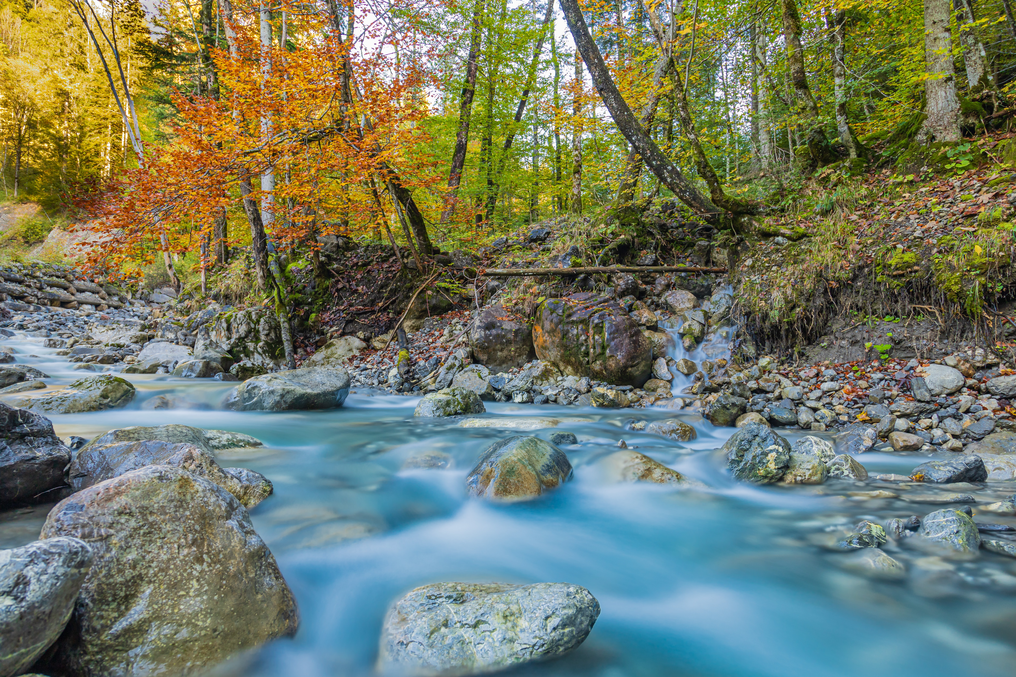
Questions?

